Slide 1
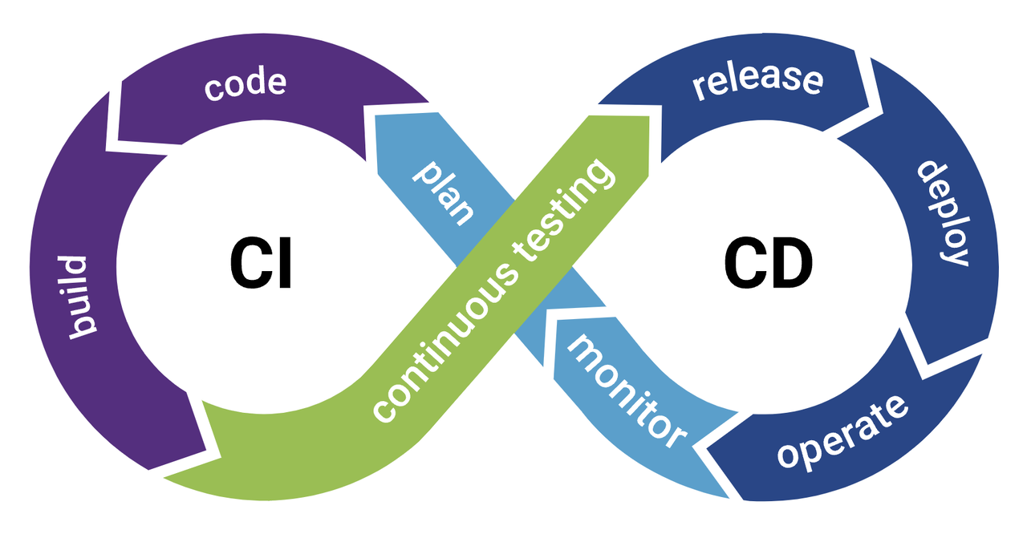
Azure Ci/Cd Pipelines

Slide 2
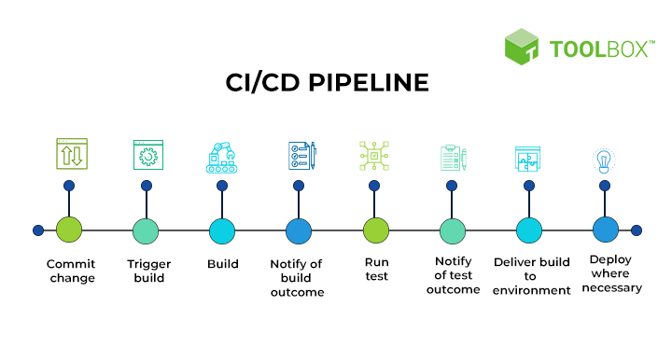
Introduction to CI/CD
Continuous Integration (CI): The practice of automatically integrating code changes from multiple contributors into a shared repository several times daily. Each integration is verified by an automated build and automated tests to detect integration errors as quickly as possible.
Continuous Deployment (CD): The practice of automatically deploying every code change that passes automated tests to production, ensuring that the software is always in a releasable state.

Slide 3
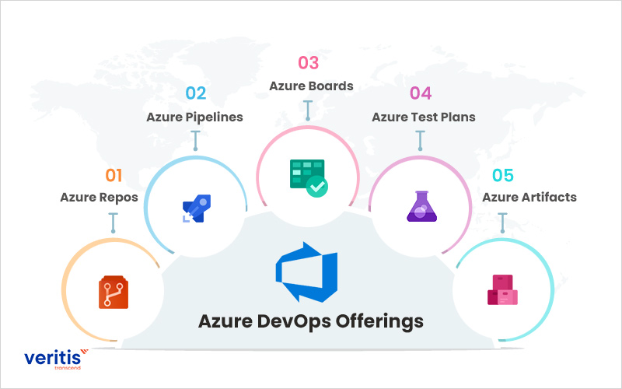
Overview of Azure DevOps
A suite of development tools and services provided by Microsoft to support the entire software development lifecycle. It encompasses a range of services that help teams to plan, develop, test, deliver, and monitor applications. The core services include:

Slide 4
Azure DevOps Services:
Azure Repos: A set of version control tools that you can use to manage your code. Includes Git repositories or Team Foundation Version Control (TFVC).
Azure Pipelines: A cloud service you can use to build and test your code project automatically and make it available to other users. It combines continuous integration (CI) and continuous delivery (CD) to test and build your code and ship it to any target.

Slide 5
Azure Boards: A service that provides interactive and customizable tools for managing software projects. It supports agile planning, work item tracking, visualization, and reporting tools.
Azure Test Plans: A service that provides a browser-based test management solution for exploratory, manual, and user acceptance testing.
Azure Artifacts: A service that provides integrated package management with support for Maven, npm, Python, and NuGet package feeds from public and private sources.

Slide 6
